Slide 1



Treating Imbalance Data
Prepared by:
Zhuoran Li
Yuanliufang Tao
Liu Xin
October 29, 2020
MMF 1922: Data Science (Fall 2020)

Slide 2

Content
1
Problem Statement
2
Choose appropriate dataset
3
Examine ways to treat imbalance datasets
4
Compare results prior and after imbalance dataset treatments

Slide 3



What is Imbalance Data?
Introduction
The imbalanced data refers to the uneven number of samples in each category in the data set.
Sample imbalance occurs in many real-world applications.
Finance
Manufacturing
Internet
fraudulent transaction detection
product quality detection problem
spam email filtering
Sample imbalance may cause classifiers have a serious bias and probably cause poor predictive performance.
The research objective of this project is using Python to treat imbalanced data using two methods, which are under-sampling and SMOTE. And we will compare outcomes using criteria such as recall and ROC curve to determine whether the imbalance data lead to the classification problem and which classifier is better.

Slide 4
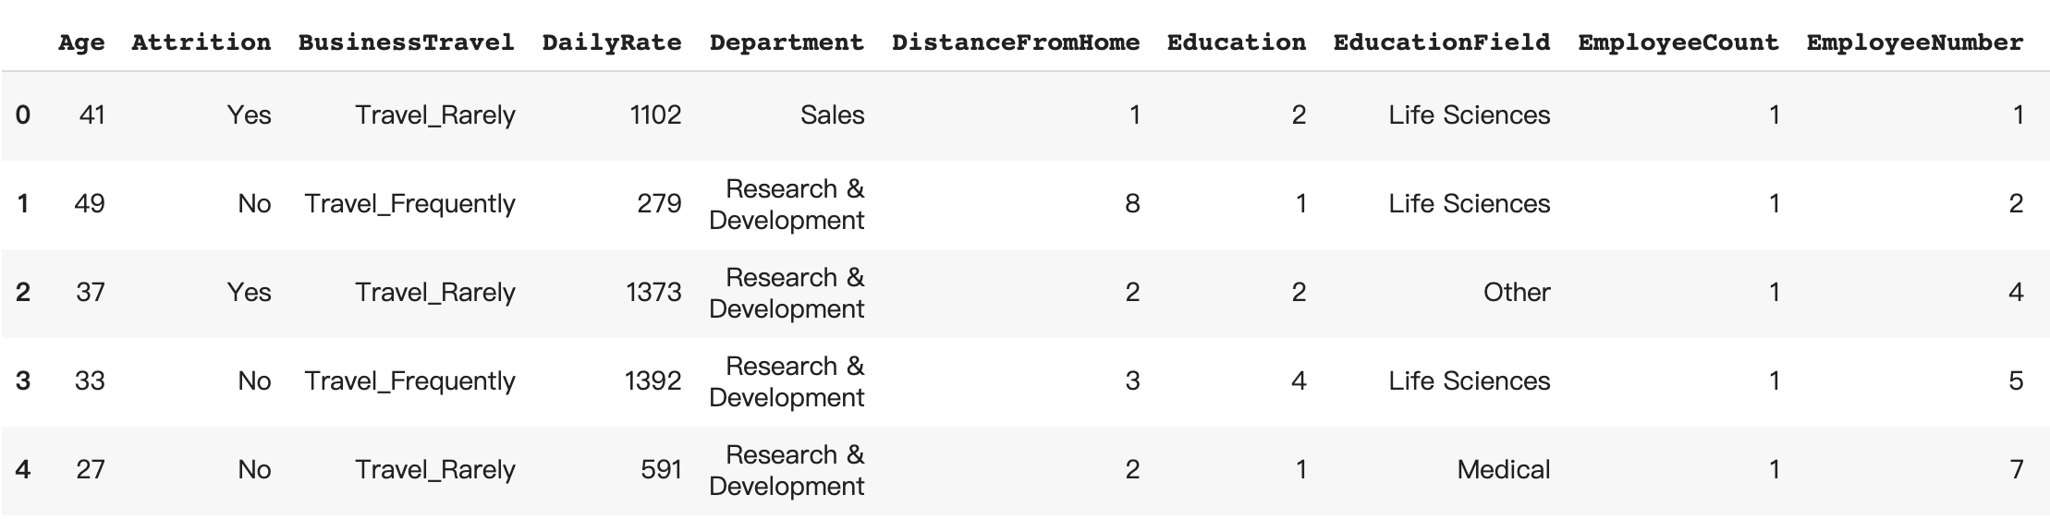
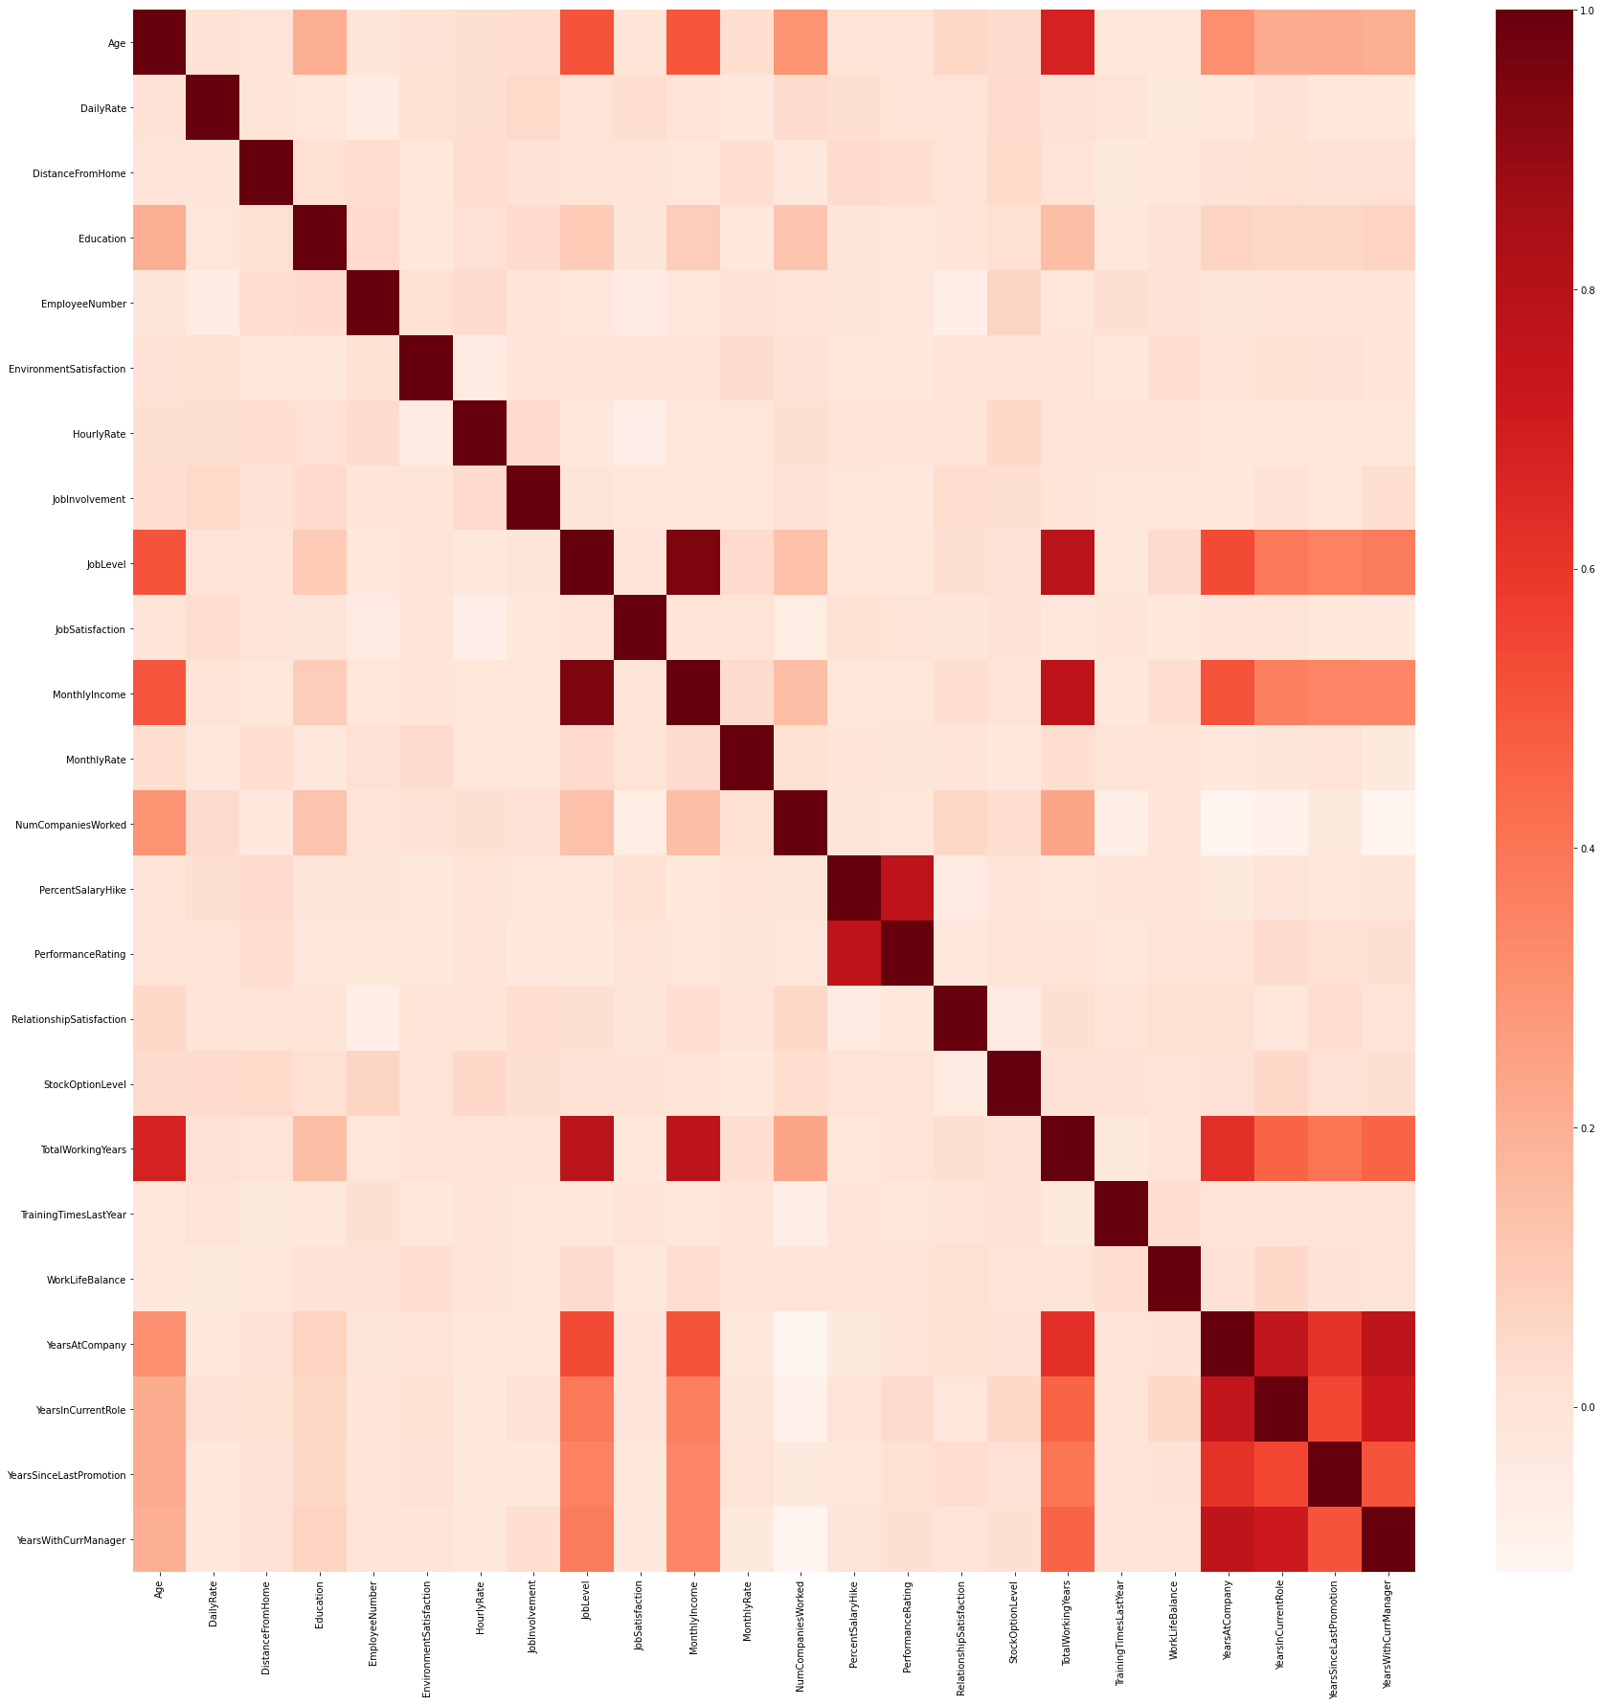
Explore Data Analysis
IBM HR Analytics Employee Attrition and Performance Data
Heatmap
1
2
3
preview data
cleaning data
variable correlation
Data set has 1470 samples
Target is attrition
Mixture of categorical and numerical data
use isna.sum()to perform the data quality check, to look for any null values
dataset does not have null data
numerical variables roughly have no strong correlation between each other
no need for us to consider dimension reduction now

Slide 5
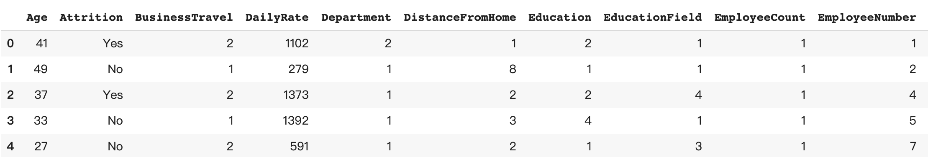
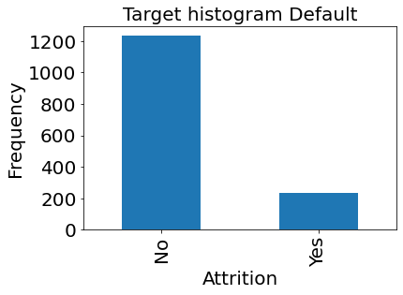
Feature Engineering and Categorical Encoding
Data after encoding
Histogram
Problem
Reminder
‘No’ vs. ‘Yes’ ≈ 6 : 1, the amounts of two classes are very different.
There might exist an imbalance data problem.

Slide 6
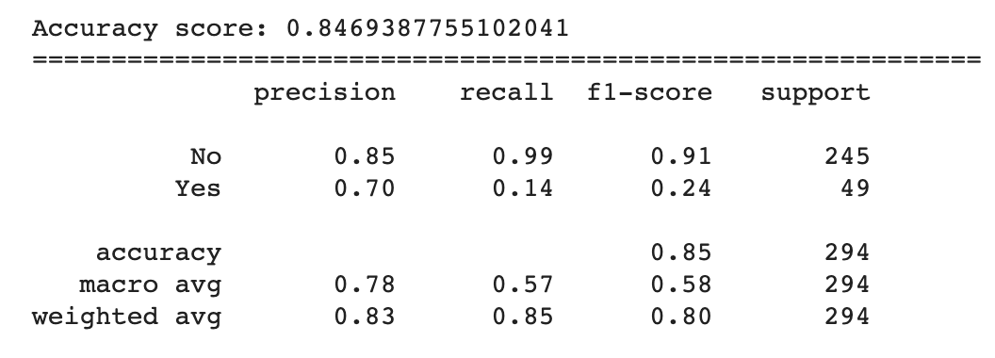
Implementing Machine Learning Models
1
2
3
split data
train
test result
sklearn
training data vs. test data = 8:2
Random Forest
machine learning process
classification_report
test result
default classifier score
Choose correct criteria
We are concerned more on resign and we regard 'Yes' as a positive target
Precision: how many attrition employees we predict are indeed resigned
Recall: how many resigned employees are detected
There EXISTS an imbalance data problem and next we will treat this imbalance dataset using
undersampling and smote methods respectively.

Slide 7
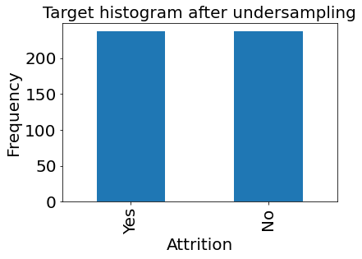
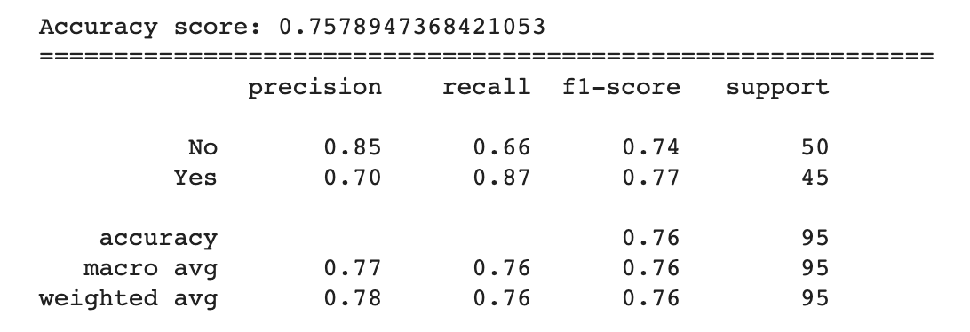
Under-sampling
Algorithm: balance data by randomly deleting part of majority class data until the number of majority and minority are roughly balanced.
Receipt
Under-sampling is implemented by using RandomUnderSampler function in Python
Follow the split, train, test result procedure
Recall is 0.87
Histogram
Under-sampling classifier score

Slide 8
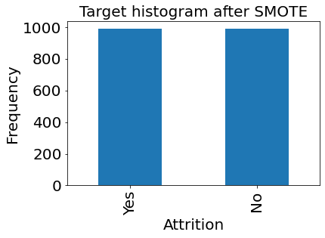
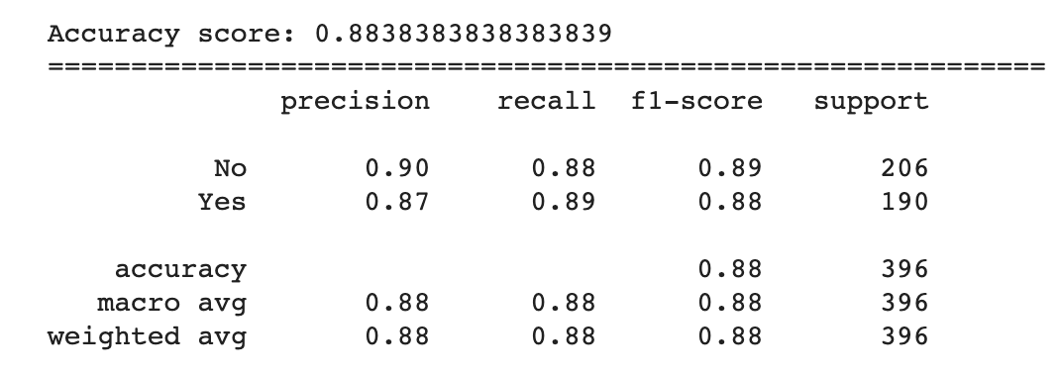
SMOTE
Algorithm: balance data by artificially ‘producing’ some minority data to achieve a balanced sample using KNN.
Receipt
Under-sampling is implemented by using sm.fit_resample in Python
Again, follow the split, train, test result procedure
Recall is 0.89
Histogram
Under-sampling classifier score

Slide 9
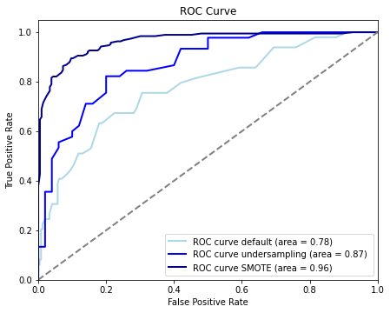
Comparison
Comparison result
ROC curve
 | Recall with “Yes” as Positive | AUC
Default | 0.14 | 0.78
Under-sampling | 0.87 | 0.87
SMOTE | 0.89 | 0.96
Recall: Default < under-sampling < SMOTE
Interpretation
According to recall, two treating methods are very efficient in dealing with the imbalance data problem. SMOTE is slightly better.
ROC curve as a supplementary to compare. Dark blue line is above the others and no overlap. SMOTE is better, which is consistent with our conclusion.

Slide 10


